Slide 1

Church Information Meeting
Update from
CBCGB Church Council
June 8, 2014
Notes:
Purpose: Plan for 2013
Attendees: KC Chu, Jack Hung, CB Chang, Liqin Chen, David Ho, Ming Tsai, Caleb Chang
The charts are updated by MJT after the meeting based on comments made during the meeting. The updates are shown in “BLUE” on the original charts or on the corresponding note page.

Slide 2
Pastoral Search Updates
On behalf of search committee and children ministry, Senior Pastor appointed Minister Steven Bowman as our next Children Minister.
Besides interviews with Search Committee, Steven, his wife Angie and daughter Abigail visited us on 5/16, Friday and 5/18 Sunday.
Minister Steven has accepted our offer and will report to CBCGB service on October 1st.

Slide 3
Pastoral Search Updates
After the CM_FM_PSC longer than 9 months of seeking, prayer, and serious interviews, an internal candidate has been singled out.
BoE final approval of Senior Pastor’s appointment is pending. Please pray for confirmation from both sides.

Slide 4
Church Vision
With requests from many church members, BoE has been planning to develop church vision for years
BoE formally suggested vision planning in January meeting
Communicated with CC in March
Elders started prayer meeting in April

Slide 5
Church Vision
Have consulted EM and a few experts in vision and strategic planning
Will be a major topic in June CC Retreat, hope to have a solid plan for the process
Will keep congregation updated
Please pray for the process

Slide 6
CBE Project Activities
  Phase I part 1
  Re-design completed in Feb/Mar., ‘14
  Contractor Search completed in April, ’14
  Signed the contract with Principal Construction Group LLC on 5/4/2014 with GMP $1,053K
  Demolition/Design Alteration permit expected to be approved in June, 14
  Construction Start expected in June. ‘14
Phase I part 2
  Entire Site Plan Survey completed in Jan. ’14
  Permit Application to be submitted in June, ’14
Phase II, Phase III
  Design Review among BOE, CC, EM/CM co-workers from Dec., ’13 to March,’14
  Church Facility usage survey from March to May, ‘14
Newsletter/Website
  Newsletter1 published in Feb., ‘14
  Newsletter2 planned to publish in June, ‘14.

Slide 7
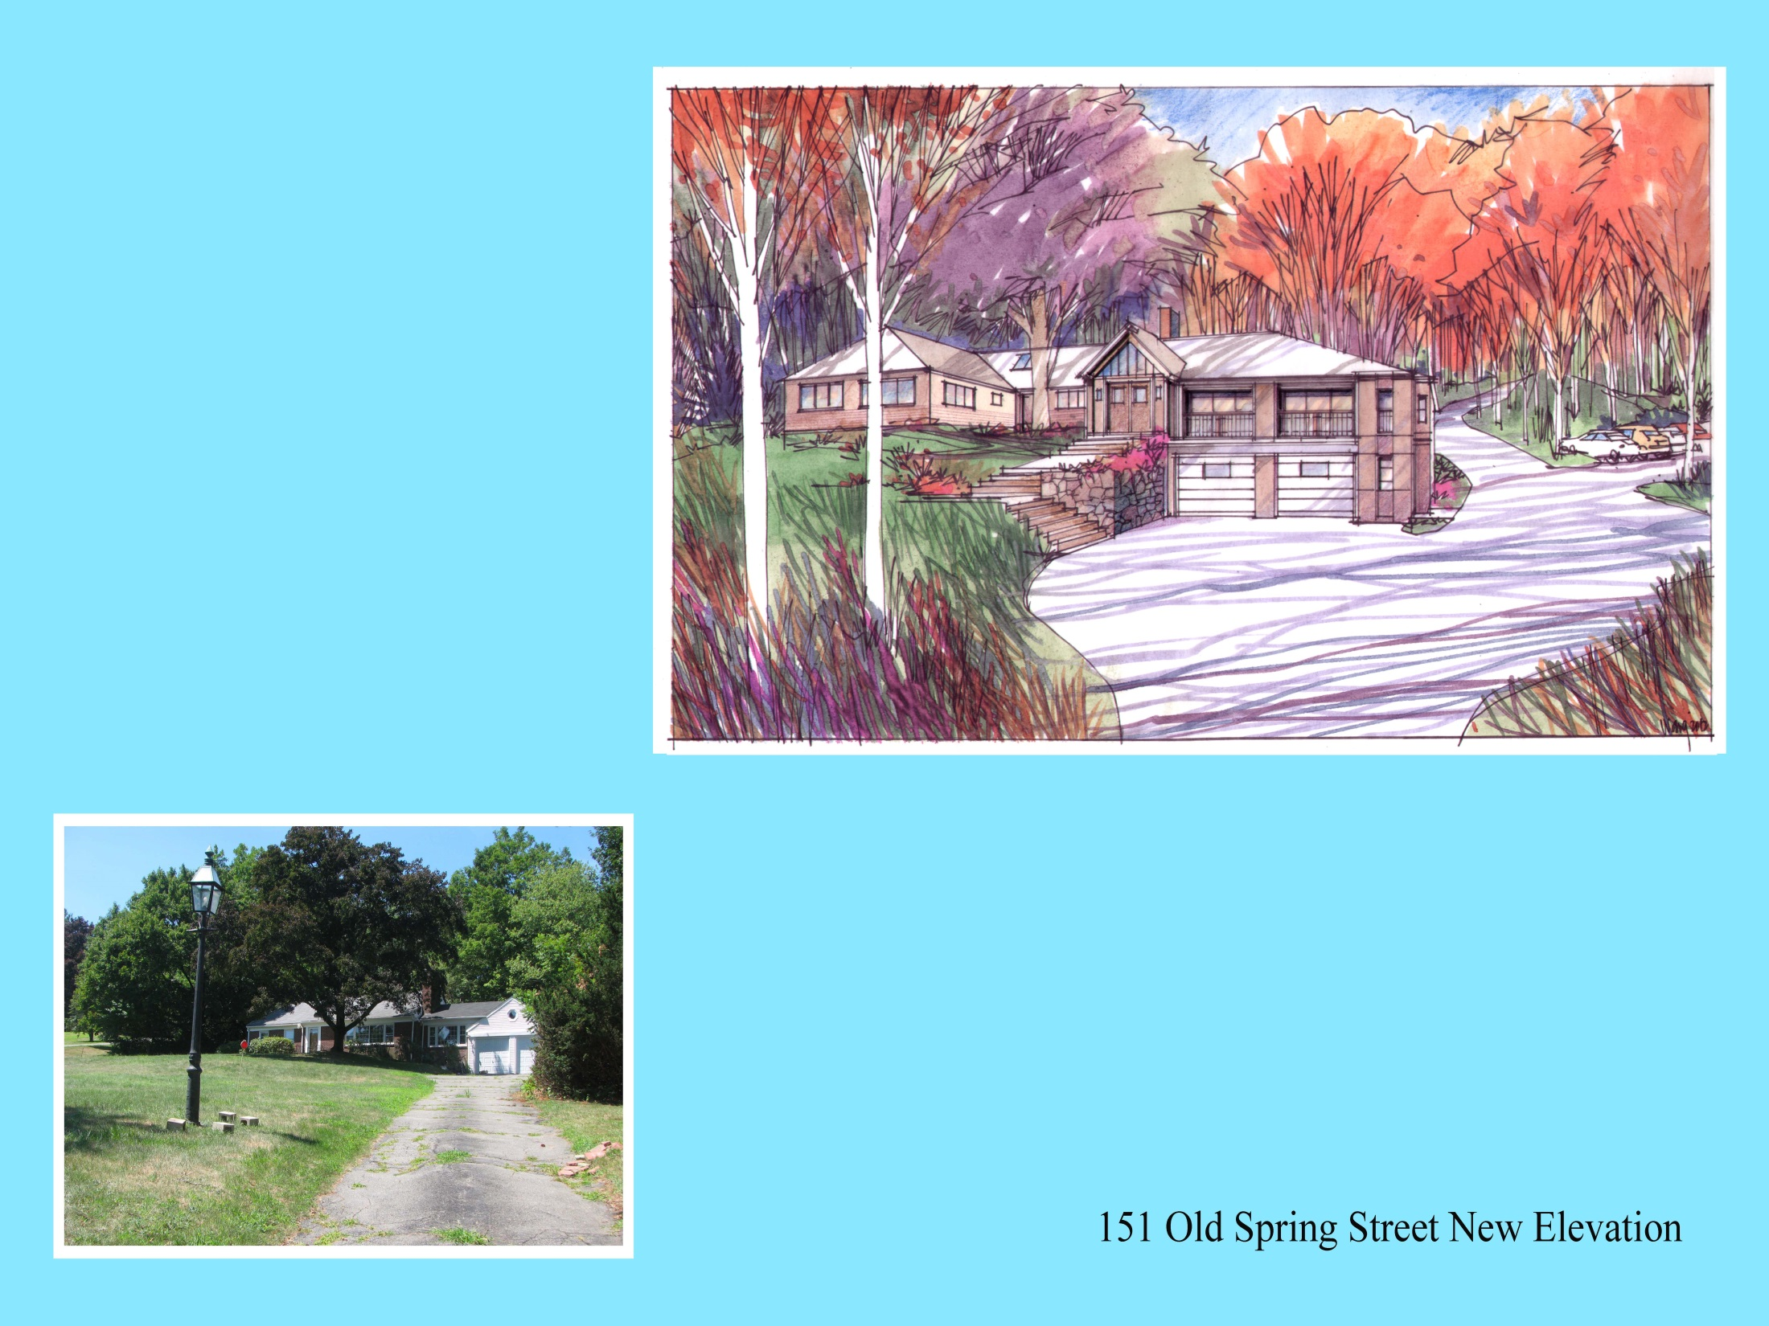
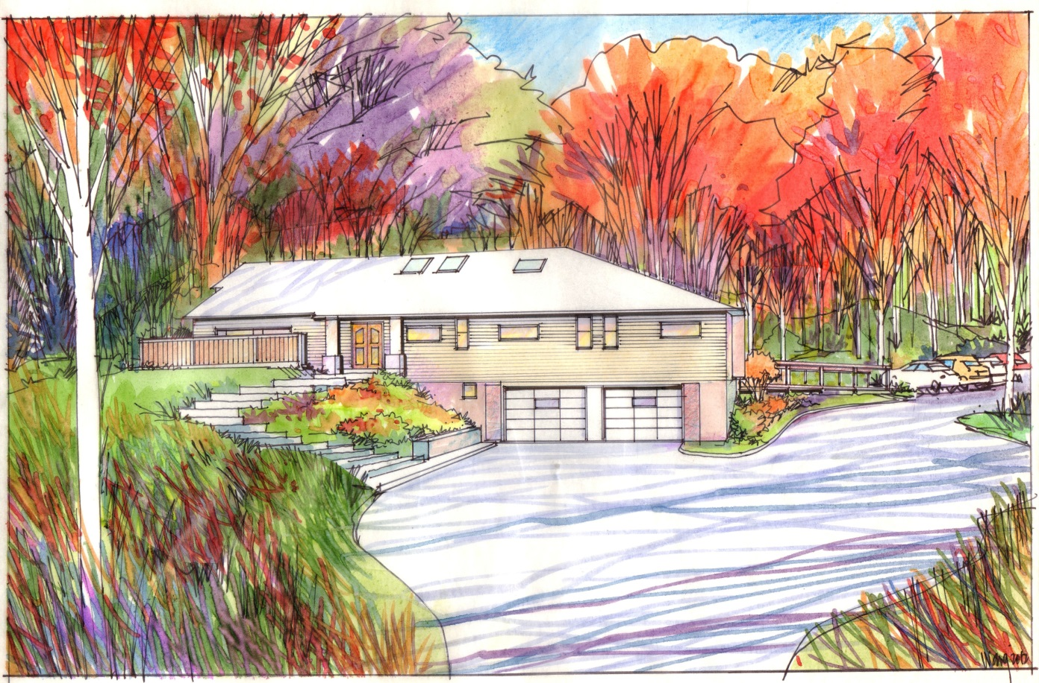
Phase I Part 1

